Slide 1
DIYOTRIM MAITRA
MASTER OF DATA SCIENCE
CHRIST UNIVERSITY, BANGALORE

Slide 2
Problem Statement
Problem Statement: Banks face significant challenges due to high customer churn rates, leading to substantial revenue losses and increased customer acquisition costs. The ability to predict which customers are likely to churn is crucial for implementing targeted retention strategies and improving overall profitability.
End Output:
Reduced Churn Rates
Enhanced Customer Retention
Increased Profitability

Slide 3
Solution Flow
Data Collection: Used a dataset containing customer profiles, transaction data, and account details
Data Preprocessing: Handle missing values and encode categorical features into numeric formats
Feature Engineering: Select relevant features and apply transformations such as normalization or scaling
Model Training: Train the model using XGBoost algorithm with training and testing data.
Model Evaluation: Evaluate model performance with metrics like accuracy, precision, recall, and F1-score, and validate through cross-validation
Deployment: Integrate the model into the bank’s system for real-time predictions and monitor its performance continuously

Slide 4
Dataset Description
Customer
customer_id: Unique identifier for each customer.
age: Age of the customer.
gender: Gender of the customer.
estimated_salary: Estimated annual salary of the customer.
Account
balance: Current balance in the account.
tenure: Number of years the customer has been associated with the bank.
products_number: Number of different banking products the customer uses.
credit_card: Indicates whether the customer has a credit card (Yes/No or 1/0).
active_member: Indicates whether the customer is an active member of the bank (Yes/No or 1/0).
Bank Details
credit_score: Credit score of the customer.
country: Country where the customer resides.
Churn Info
churn: Whether the customer has churned (1 if churned, 0 if not).

Slide 5

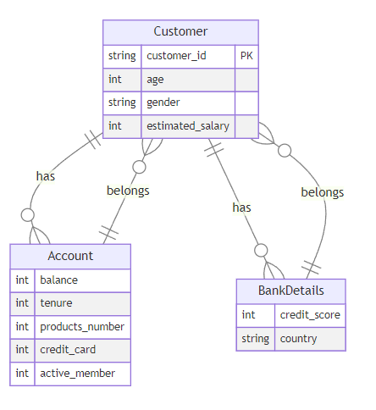


Data Model

Slide 6
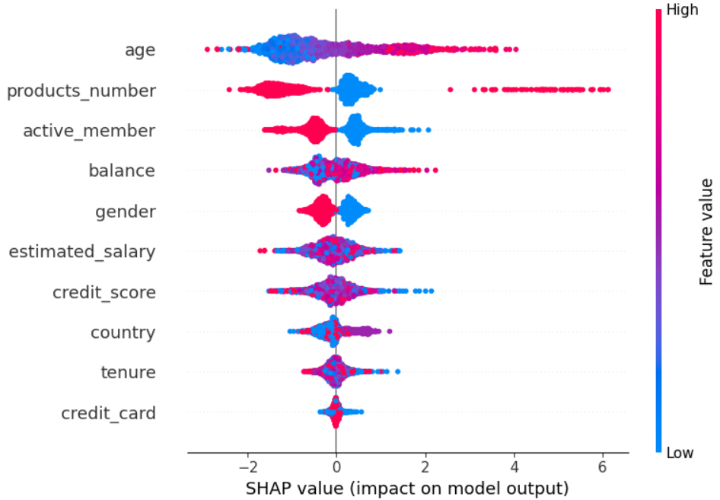
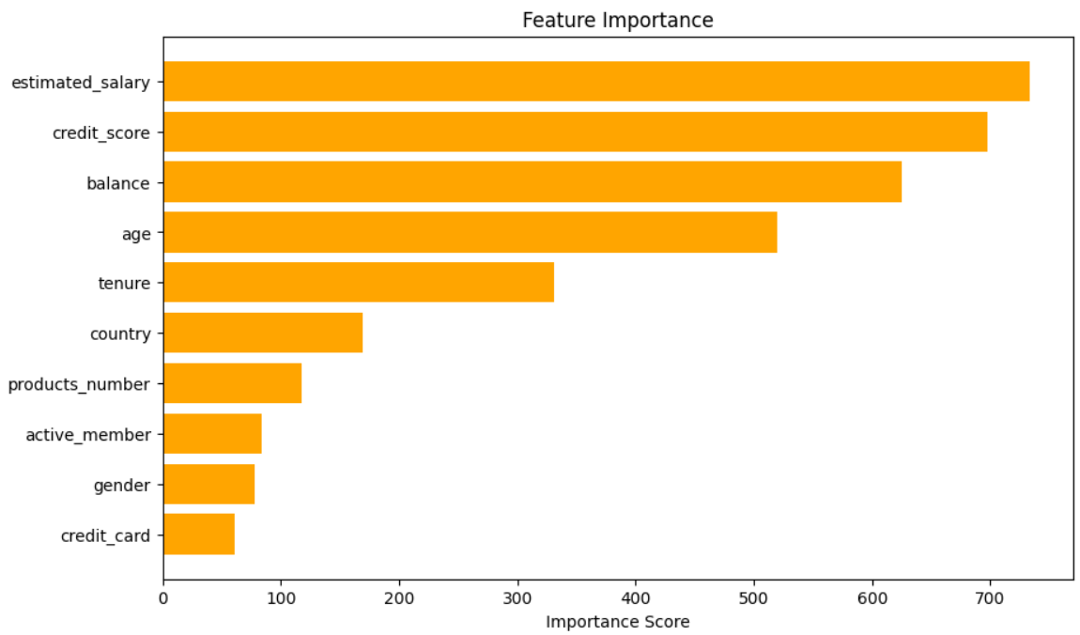
SHAP and Feature Importance

Slide 7
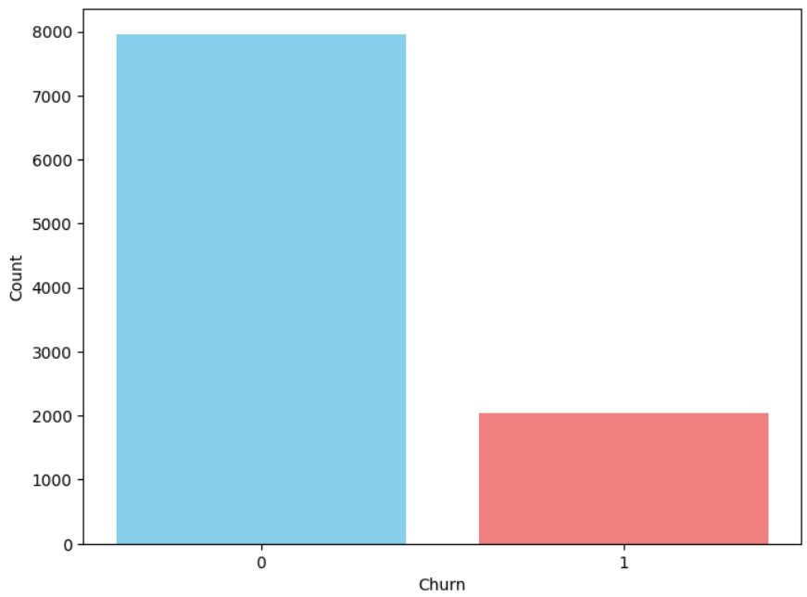
Model Selection
Algorithm Choice:
XGBoost (Extreme Gradient Boosting):
Reason: Effective for handling structured/tabular data with high accuracy.
Advantages: Handles missing values, regularization to avoid overfitting, and fast execution.
Count of Customers who has ‘Churned (1)’ and who has
‘Not Churned (0)’

Slide 8
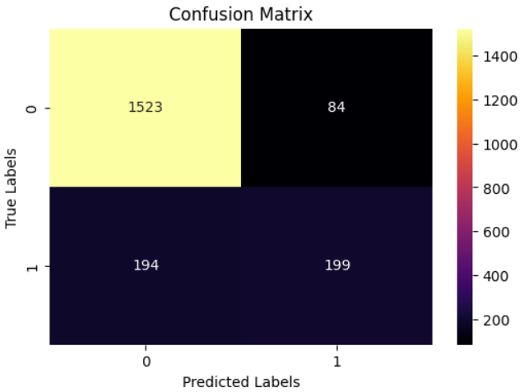
Model Performance
Evaluation Metrics | Values | Description
Accuracy | 86% | The model correctly predicts the target variable for approximately 86% of the samples.
Precision | 85% | ~85% of the positive predictions made by the model are true positives, indicating its ability to minimize false positives.
Recall | 86% | ~86% of all true label predictions made by the model are correct.
F1 Score | 85% | Not available, as MSE is generally used for regression tasks, not classification.

Slide 9
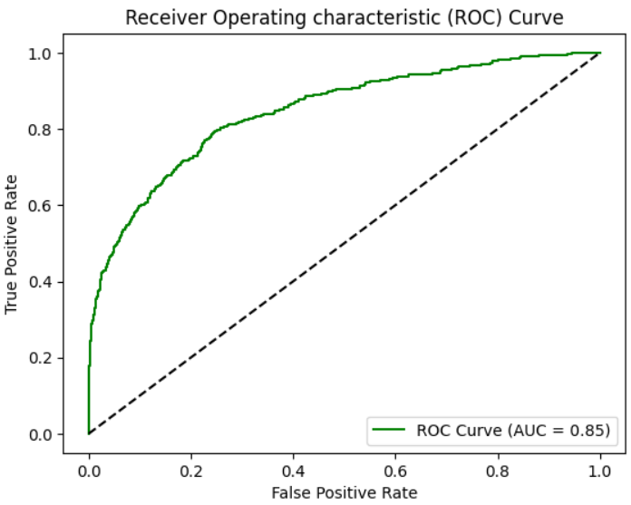
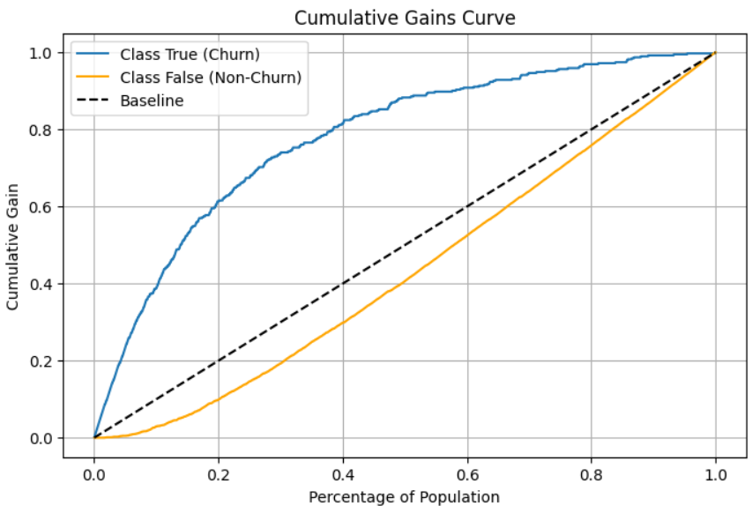
ROC Curve and Cumulative Gains Curve
The Cumulative Gains Curve shows that the model is performing significantly better than a random model. The blue line, representing the true class (churn), is above the baseline, indicating that the model is able to correctly identify a higher proportion of churn cases compared to a random guess.
The ROC Curve shows that the XGBoost model has an AUC of 0.85, which indicates good overall classification performance. The curve is closer to the top-left corner, indicating a high true positive rate and low false positive rate, suggesting that the model is effective in identifying true positive cases while minimizing false positives.

Slide 10
Model Deployment
Features:
Interactive Prediction: Users can input customer data directly for churn predictions via a user-friendly interface.
Batch Prediction: Supports CSV file uploads to evaluate churn risk across large datasets efficiently.
Deployment:
Successfully deployed on Render Platform.
Access:
Live Model: https://customer-churn-prediction-model.onrender.com
Demo Dataset: https://docs.google.com/spreadsheets/d/1axZo4fqGzeY56BEGvF7Xgc-IVisVWAWpw5td2fSvX7c/edit?usp=sharing

Slide 11
Results
High Credit Score & Lower Churn: Customers with credit scores above a certain threshold are less likely to churn.
Age Impact: Younger customers (ages 18-30) exhibit higher churn rates compared to older age groups.
Tenure Correlation: Customers with longer tenure (more years with the bank) tend to have lower churn rates.
Balance and Product Holding: Customers with higher account balances and multiple products are more engaged and less likely to leave.
Active Membership Status: Active members who frequently interact with the bank show significantly lower churn rates.

Slide 12
Recommendations
Implement Targeted Retention Campaigns: Focus on at-risk customers identified by low credit scores or minimal engagement.
Personalize Communication Strategies: Tailor messages and offers based on customer demographics and behavior.
Introduce Loyalty Programs: Reward long-term customers with incentives to enhance their loyalty and reduce churn.
Launch Customer Engagement Initiatives: Organize events or programs that encourage active participation from customers.
Establish Regular Feedback Mechanisms: Continuously gather customer feedback to identify pain points and improve services.

Slide 13
THANK YOU

